Slide 1

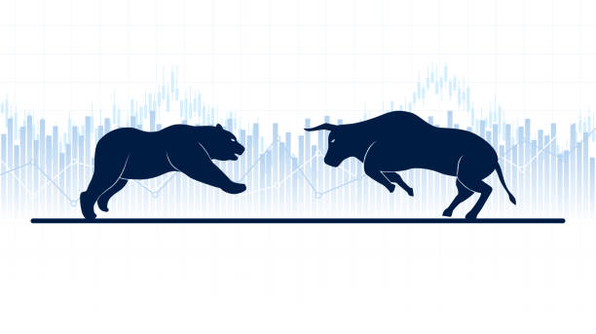
“Stock forecasting and markowitz’s Portfolio Optimization”
UE18CS390A – M.Tech
Project Review #4
Project Guide : Vivekananda
Student Name : Rajath Hegde

Slide 2
CONTENTS
01
Phase 1 Review
02
Novelty Proposal
03
Abstract
04
Algorithms Used
05
Literature Survey
06
References

Slide 3
ABSTRACT of PHASE-I
Problem Statement:
The goal of the project is to design a portfolio which provides a highest return for a given risk taken with a particular set of diversified stocks.
PART 1:
In this project, I will be attempting to perform stock price prediction using Facebook Prophet, ARIMA and L.S.T.M and the optimum model would be taken into consideration for designing a Diversified Portfolio consisting of 10 stocks in total using RMSE and MAPE.
8 stocks from various sectors (Cement, IT etc).
2 Exchange Traded Mutual Fund(NiftyBeES, BankBeES).
PART 2:
Along with the forecasting I will also perform Markowitz’s Optimization technique i.e. Efficient Frontier Model using Scipy optimizer and Monte Carlo simulation in order to obtain a portfolio with the highest Sharpe Ratio.

Slide 4
PORTFOLIO SELECTION
The 10 Diversified Equity Portfolio stocks consists:
COMPANIES | SECTORS
Reliance Industries Ltd. | Diversified business.
Cipla. | Pharmaceutical.
Maruti Suzuki. | Automobile.
Hindustan Unilever. | Fast-moving consumer goods.
ICICI Bank. | Financial services.
Nestlé India. | Fast-moving consumer goods.
Tata Consultancy Services. | Information technology.
Ramco Cements. | Cement.
Nifty BeES. | E.T.F.
Bank BeES. | E.T.F.

Slide 5
ALGORITMS/TECHNIQUES
Primarily focusing on 3 models:
Autoregressive integrated moving average(ARIMA).
Long short-term memory(LSTM model).
Facebook Prophet.

Slide 6
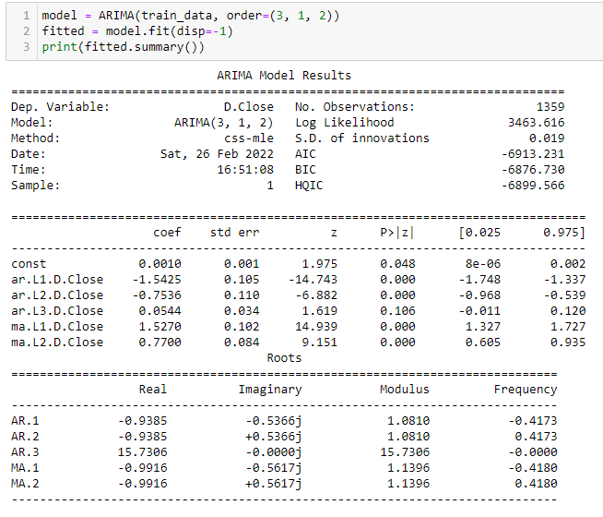
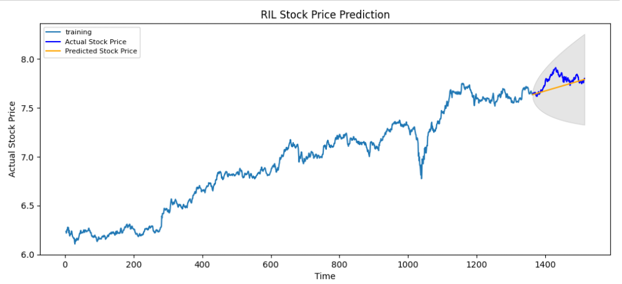
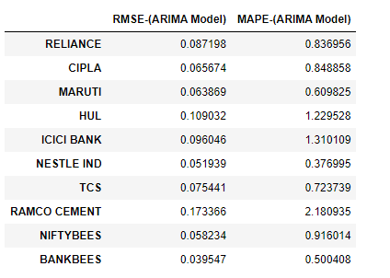
A.R.I.M.A. Model

Slide 7
A.R.I.M.A. Model

Slide 8
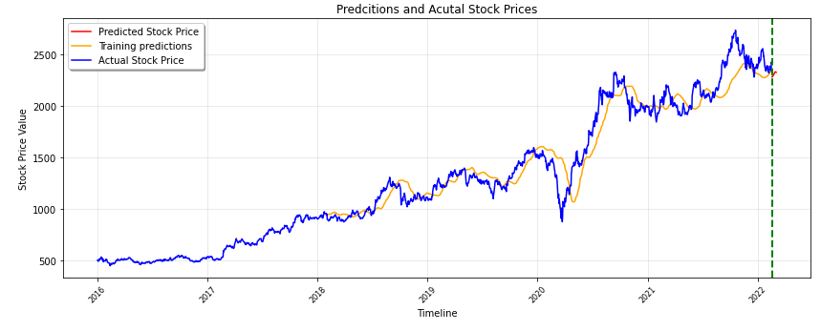
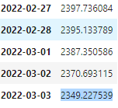
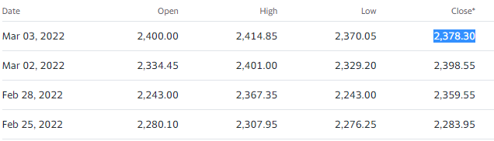
L.S.T.M Model
Predicted Closing Price
Actual Stock Price

Slide 9
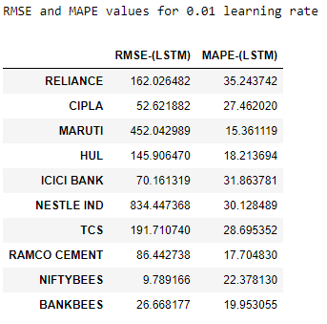
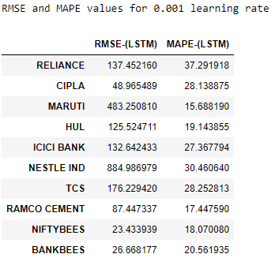
L.S.T.M Model

Slide 10
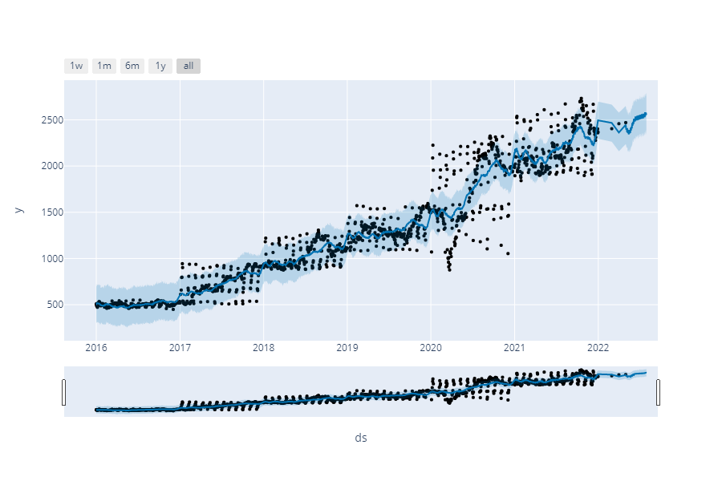
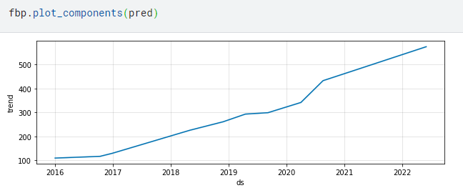
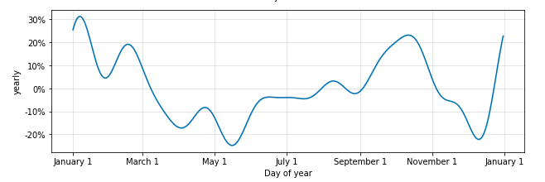
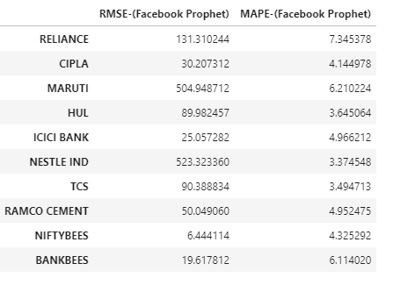
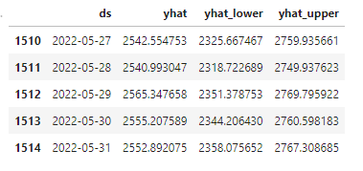
Facebook Prophet

Slide 11
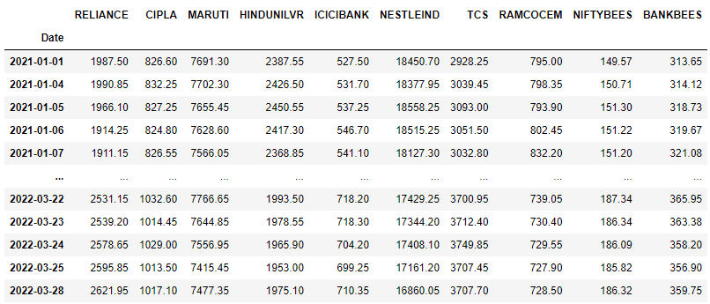
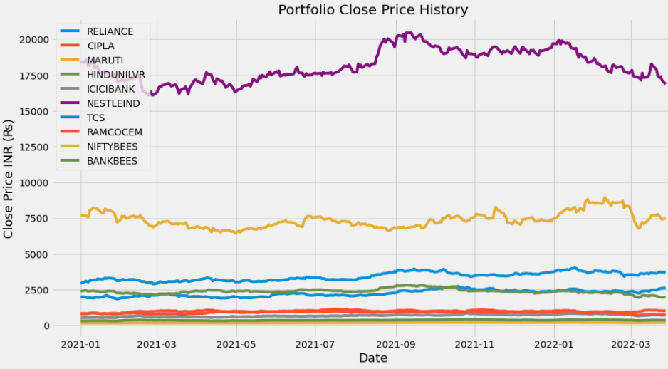
Markowitz’s Efficient Frontier Model

Slide 12
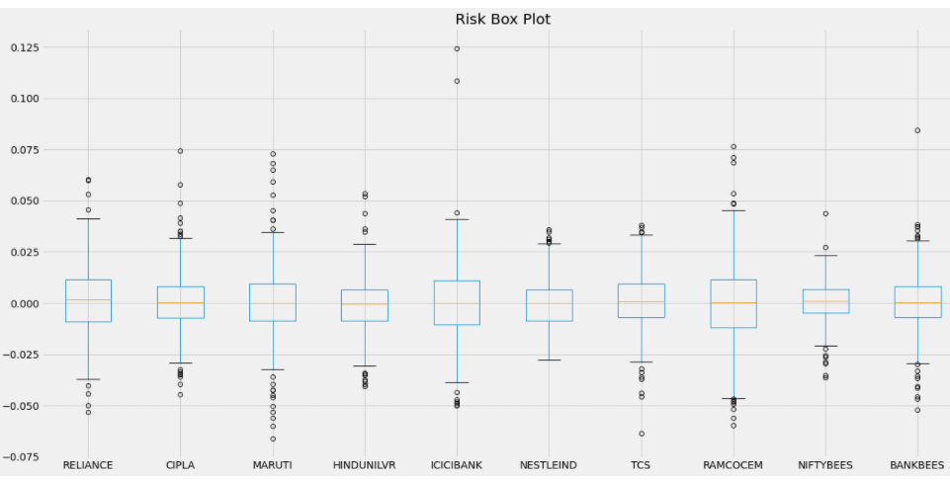
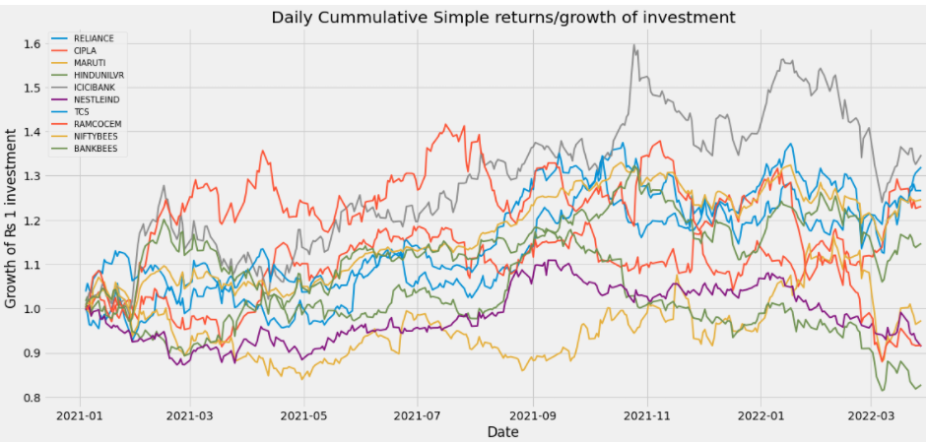
Risk Plot and Growth of investment

Slide 13
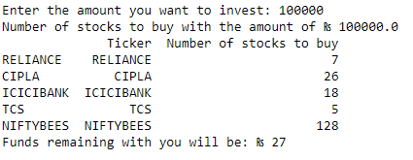
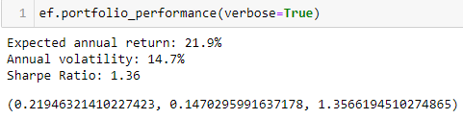
Fund allocation and Sharpe ratio

Slide 14
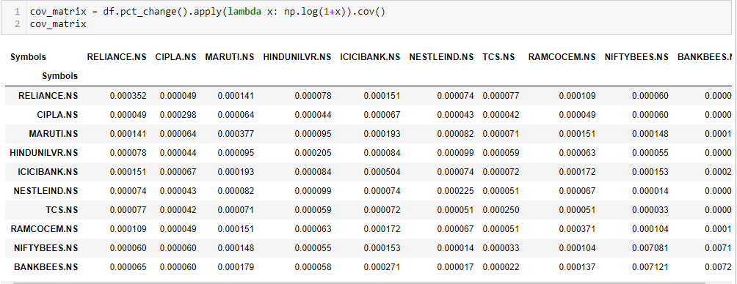
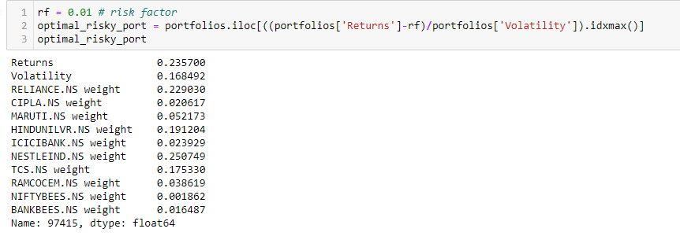
Efficient Frontier Model - 6 year data

Slide 15
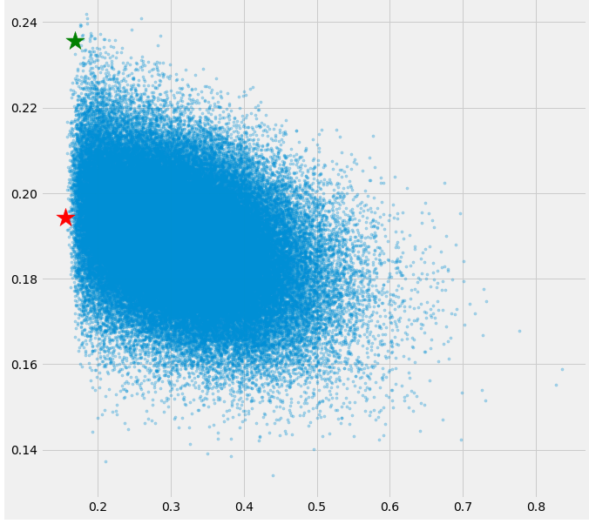
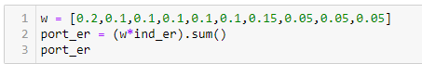
Optimal Risk for the portfolio

Slide 16
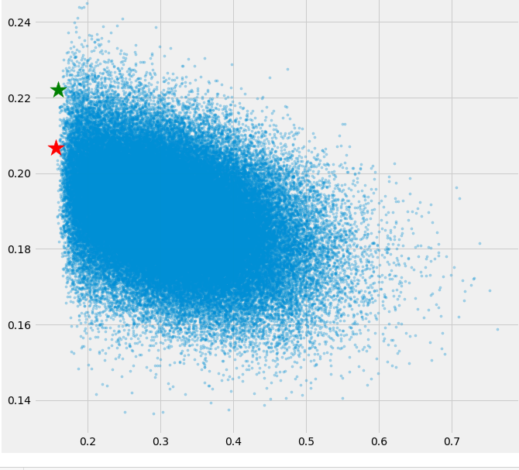
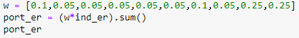
Optimal Risk for the portfolio

Slide 17

Novelty Ideas for PHASE-II
Twitter Sentiment Analysis of Stocks

Slide 18
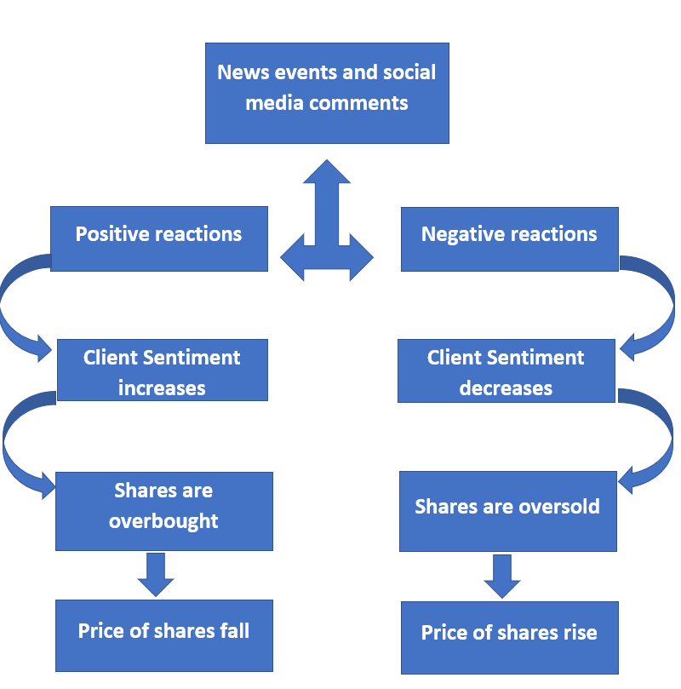
ABSTRACT of PHASE-II
Problem Statement:
The goal of the project is to understand the sentiments of people using the twitter sentiment analysis and categorizing whether the sentiments are positive, negative or neutral and their impact on the stock prices.

Slide 19
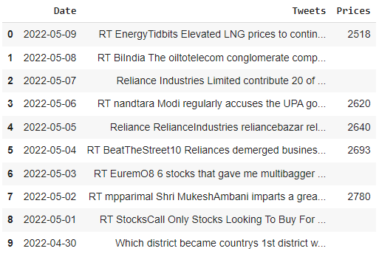
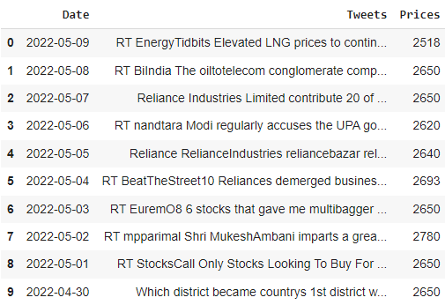
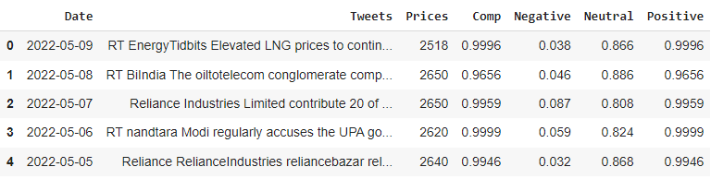
Twitter Sentiment Analysis of RELIANCE
Tweets along with their Prices
Tweets along with their Prices as mean for days with holidays
Tweets, Prices along with their sentiments

Slide 20
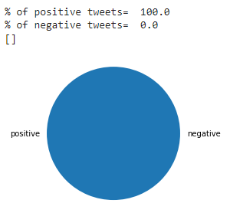
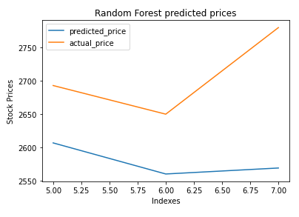
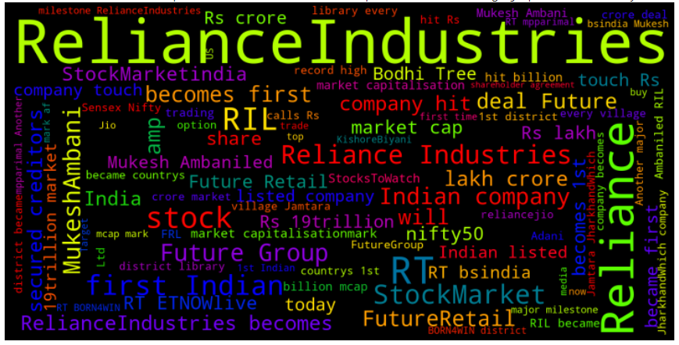
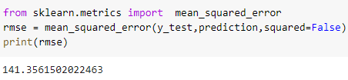
Twitter Sentiment Analysis of RELIANCE
Positive and Negative sentiments of tweets
Random Forest (Predicted Price VS Actual Price)
RMSE of the dataset
WordCloud

Slide 21
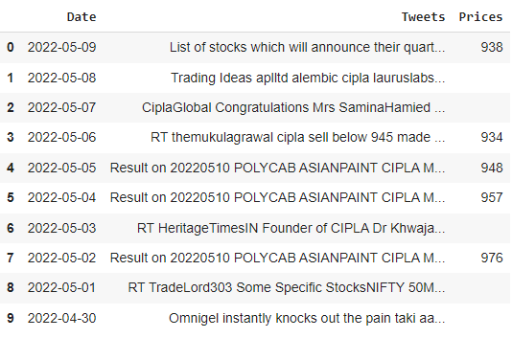
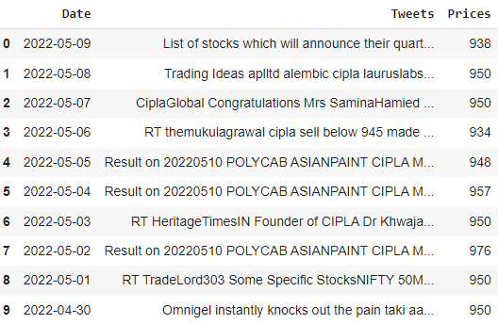
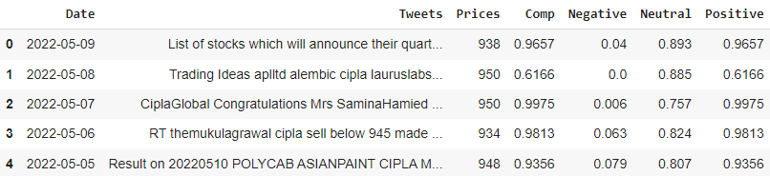
Twitter Sentiment Analysis of CIPLA
Tweets along with their Prices
Tweets along with their Prices as mean for days with holidays
Tweets, Prices along with their sentiments

Slide 22
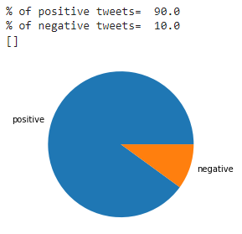
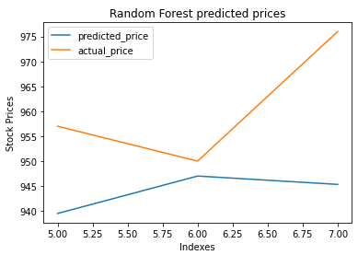
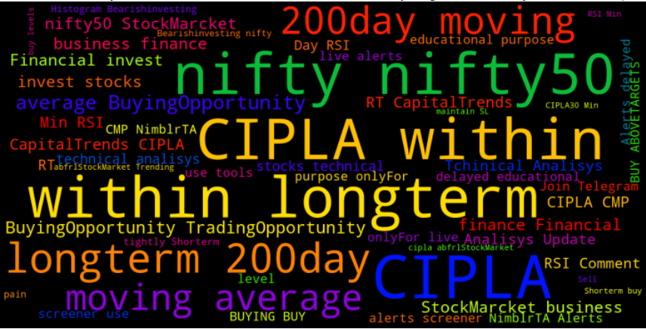
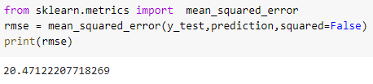
Twitter Sentiment Analysis of CIPLA
Positive and Negative sentiments of tweets
Random Forest (Predicted Price VS Actual Price)
RMSE of the dataset
WordCloud

Slide 23
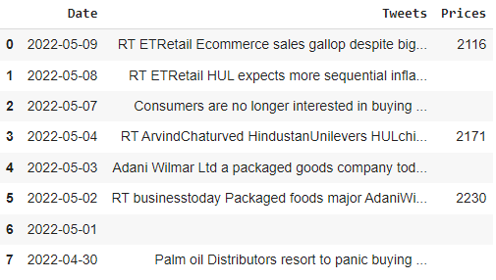
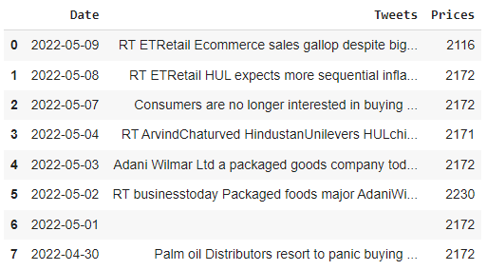
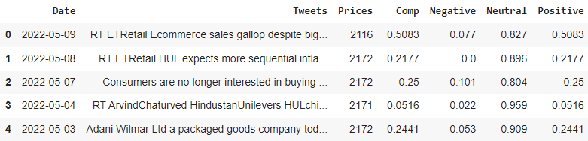
Twitter Sentiment Analysis of Hindustan Unilever
Tweets along with their Prices
Tweets along with their Prices as mean for days with holidays
Tweets, Prices along with their sentiments

Slide 24
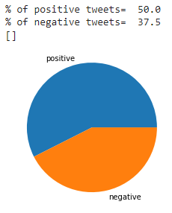
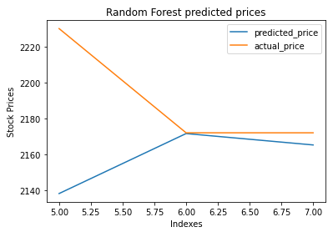
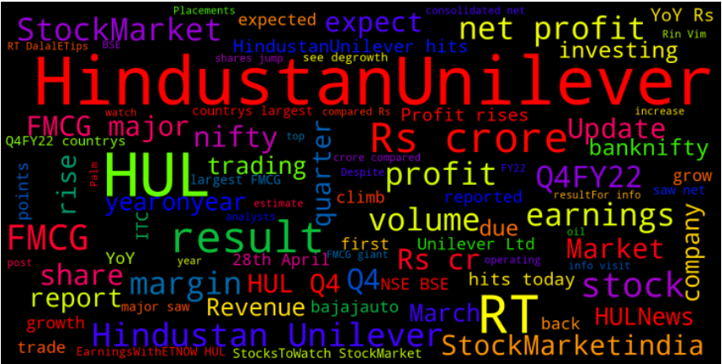
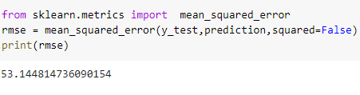
Twitter Sentiment Analysis of Hindustan Unilever
Positive and Negative sentiments of tweets
Random Forest (Predicted Price VS Actual Price)
RMSE of the dataset
WordCloud

Slide 25
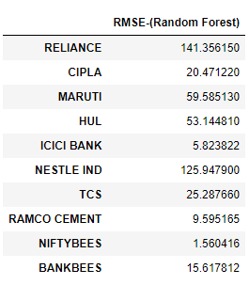
R.M.S.E of various stocks using Random Forest

Slide 26
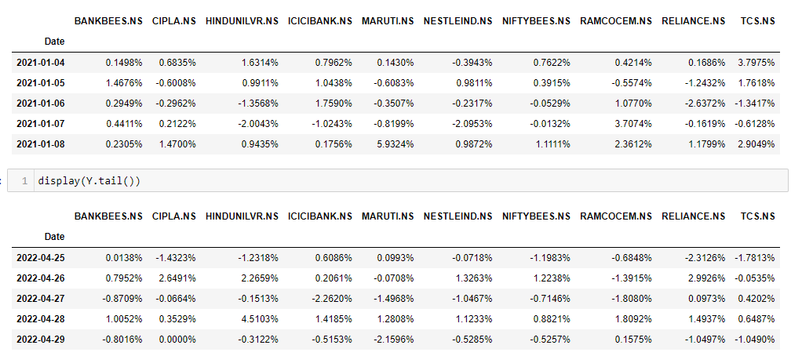

Hierarchical Risk Parity

Slide 27

Hierarchical Risk Parity

Slide 28


Hierarchical Risk Parity

Slide 29
LITERATURE SURVEY
‘Analysing stock price changes using event related Twitter feeds’
Satyabrata Aich, Hee-Cheol Kim, Mangal Sain, Bijay Bhaskar Deo
Twitter sentiment analysis of “Samsung” stock during the launch event of Galaxy Note 7 with over 200000 tweets and price movement of Samsung during that period.
‘Stock Prediction Using Sentiment Analysis in Twitter for Day Trader’
Muhammad Aiman Asraf Roslan, Mohd Hezri Fazalul Rahiman
Has used MatLab and Artificial Neural Network for twitter sentiment analysis of Apple stock
with Sentiments ranging from -1 to +5 with words like “bad”, “good”, “not good”, for a period of 6 days with a time frame of 9 am to 4 pm for intraday trading.

Slide 30
LITERATURE SURVEY
‘ Stock Market Prediction based on Social Sentiments using Machine Learning’
Tejas Mankar, Tushar Hotchandani, Manish Madhwani, Akshay Chidrawar, Lifna C.S
Comparative study between Naïve Bayes and Support Vector Machine. SVM is the most
feasible model with an accuracy of 64.10%.
Challenges faced:
Historical Twitter data cannot be obtained, unless it is saved by someone, so data has to be collected over a duration of a fixed number of months starting from the present date and time.
It is necessary to filter out required data from the stream of unrelated tweets.
Authentication is required for accessing real time Twitter data.
‘Hierarchical Risk Parity and Minimum Variance Portfolio Design on NIFTY 50 Stocks’
Jaydip Sen, Saikat Mondal, Sidra Mehtab, Abhishek Dutta
This paper proposes a systematic approach to designing portfolios using two algorithms, the critical
line algorithm, and the hierarchical risk parity algorithm on eight sectors of the Indian stock market.
Eight important sectors of NSE are first chosen. The selected sectors are: (i) auto, (ii) banking,
(iii) FMCG, (iv)information technology (IT), (v) metal, (vi) pharmaceuticals, (vii) realty, (viii) NIFTY 50. NIFTY 50 contains the 50 most critical stock from several sectors of the Indian stock market.

Slide 31
References
[1]R. Ji, K. Chang and Z. Jiang, "Risk-Aversion Adjusted Portfolio Optimization with Predictive Modelling," 2019 22th International Conference on Information Fusion (FUSION), 2019,pp. 1-8.
[2] Harry M Markowitz, G Peter Todd, and William F Sharpe Mean-variance analysis in portfolio choice and capital markets Volume 66.
[3]J. Sen, S. Mondal and S. Mehtab, "Portfolio Optimization on NIFTY Thematic Sector Stocks Using an LSTM Model," 2021 International Conference on Data Analytics for Business and Industry (ICDABI), 2021, pp. 364-369, doi: 10.1109/ICDABI53623.2021.9655886.
[4] Mehar Vijh, Deeksha Chandola, Vinay Anand Tikkiwal, Arun Kumar,Stock Closing Price Prediction using Machine Learning Techniques,Procedia Computer Science,Volume 167,
[5] ‘A Machine Learning Approach to Stock Price Prediction and Portfolio Optimization’ Jorge Barreno, Anna Skarpalezou, Arjun Tisseverasinghe.
[6] V. Kedia, Z. Khalid, S. Goswami, N. Sharma and K. Suryawanshi, "Portfolio Generation for Indian Stock Markets Using Unsupervised Machine Learning," 2018 Fourth International Conference on Computing Communication Control and Automation (ICCUBEA), 2018, pp. 1-5, doi: 10.1109/ICCUBEA.2018.8697771.
[7] J. Sen, S. Mehtab, A. Dutta and S. Mondal, "Hierarchical Risk Parity and Minimum Variance Portfolio Design on NIFTY 50 Stocks," 2021 International Conference on Decision Aid Sciences and Application (DASA), 2021, pp. 668-675, doi: 10.1109/DASA53625.2021.9681925.
[8] “Stock Market Prediction based on Social Sentiments using Machine Learning”.
[9] ‘Analysing stock price changes using event related Twitter feeds’.

Slide 32
Thank You

